Slide 1


MVSR Engineering College, Hyderabad - 501 510
Department of Computer Science and Engineering
Project Name: Data Analysis of Football using XGBoost
Batch No: A11
M.HAREEN –2451-19-733-041
NAGASREEDIVYA KINDI –2451-19-733-049
KOTHAPALLI CHANDRA SHEKAR–2451-19-733-301
Under the guidance of:-
Name: ANUPAMA MEDURI
Designation: Associate Professor, MVSREC

Slide 2
Batch No: A11 Name of the project: Data Analysis and Prediction of Football Goals
Problem Statement:
The present undertaking concerns the examination of football games, wherein each match is accompanied by an mp4 file that undergoes conversion to a JSON file, facilitating match analysis and goal prediction.
Project Scope:
This mode of analysis is implemented to be customized for other sports providing requisite data and algorithmic modifications. Given suitable datasets, an identical analytical methodology may be employed to scrutinize other sports. This adaptability confers a practical advantage to this approach across diverse sporting domains, transcending football.
Application Areas:
Through this project, a team manager can:
Simulate match results.
Analyze the performance of a team.
Optimize team tactics.
Challenges:
The major issues faced in the dataset are the existence of null values due to the suspension of a player and inconsistent match data due to the manager introducing substitutes and the change in the play-style.
Marks:5

Slide 3
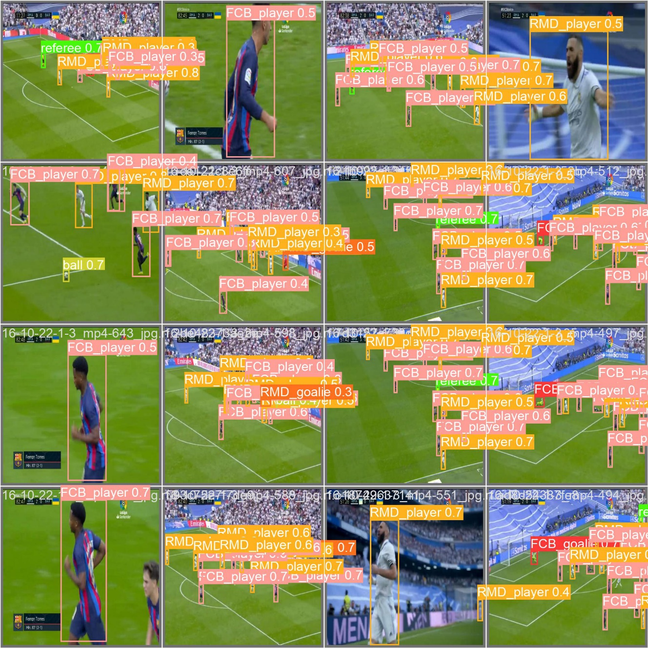
Sample Tracking Screenshots:
We annotate each frame using roboflow software. After annotation of each frame we convert the data into text data to perform analysis.
ROBOFLOW: Roboflow is a computer vision platform that allows users to build computer vision models faster and more accurately through the provision of better data collection, preprocessing, and model training techniques.

Slide 4
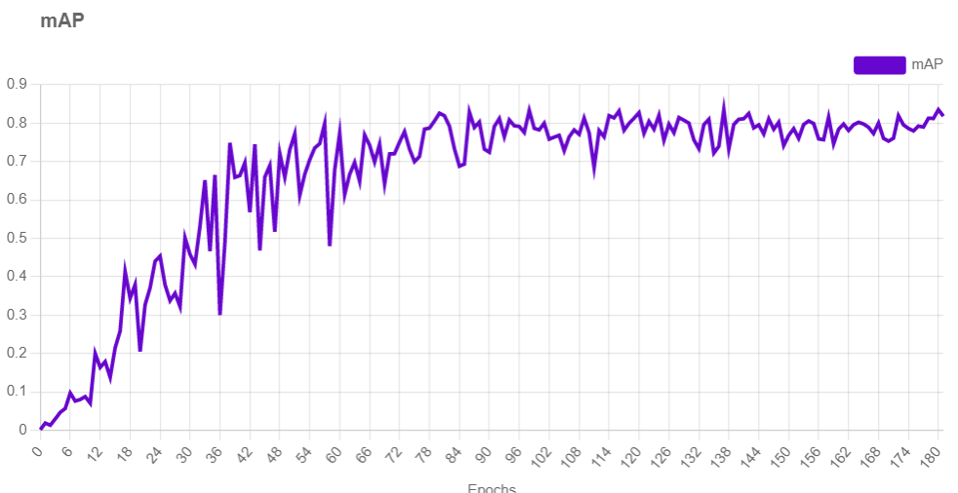
mAP of the tracking model:

Slide 5
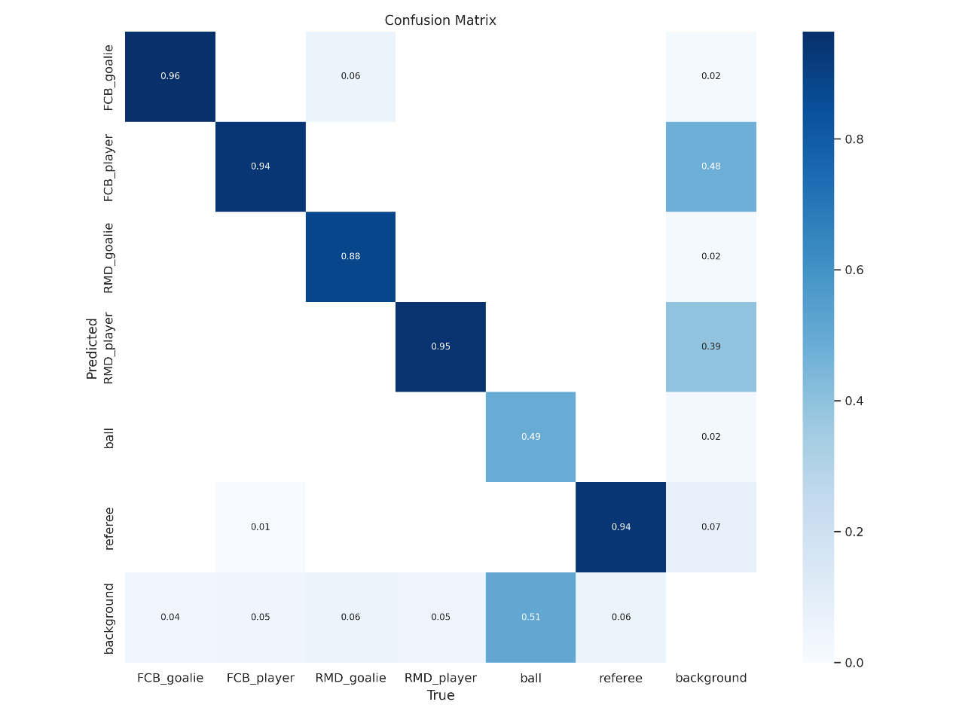
Confusion Matrix of the model:

Slide 6
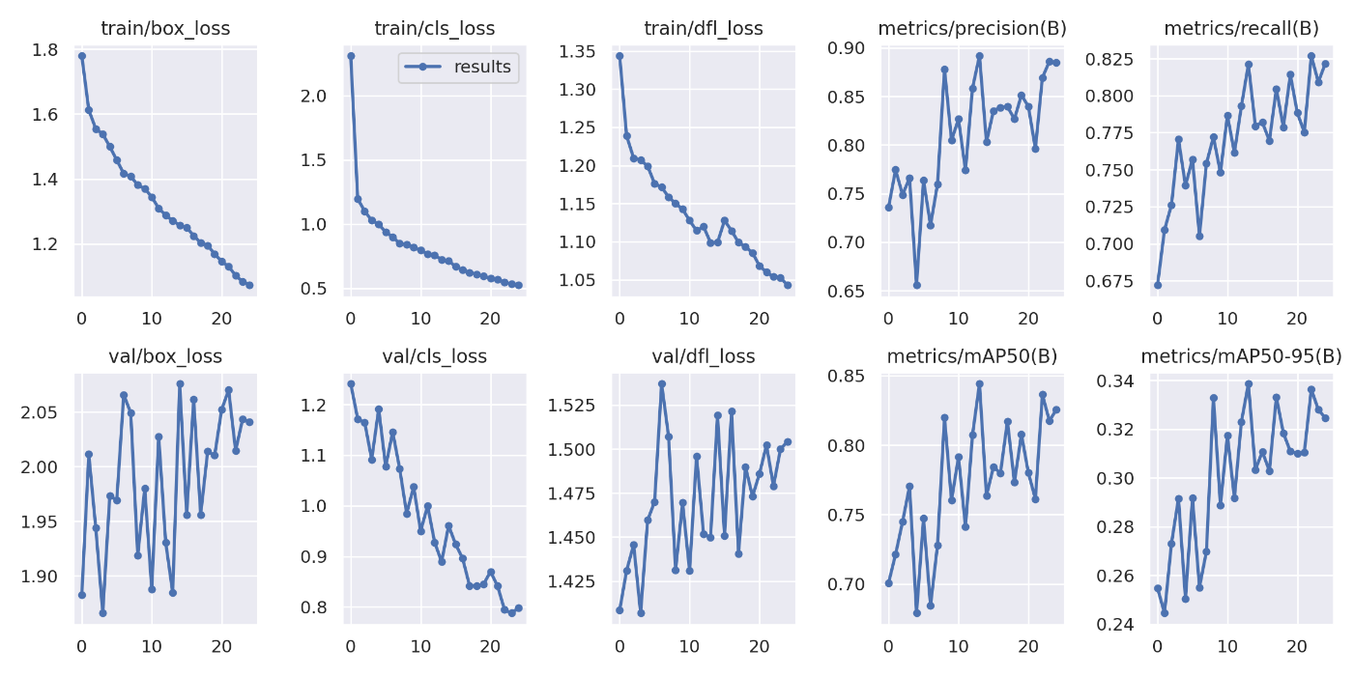
Training Metrics of Player Detection:

Slide 7
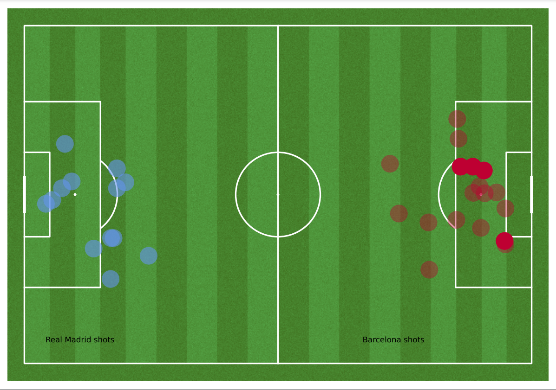
SHOT MAP
For each football match analyzed, a shot map is generated, which is a visual representation of the football pitch that displays the locations of all the shots taken during the game.
Short map of Real Madrid & Barcelona

Slide 8
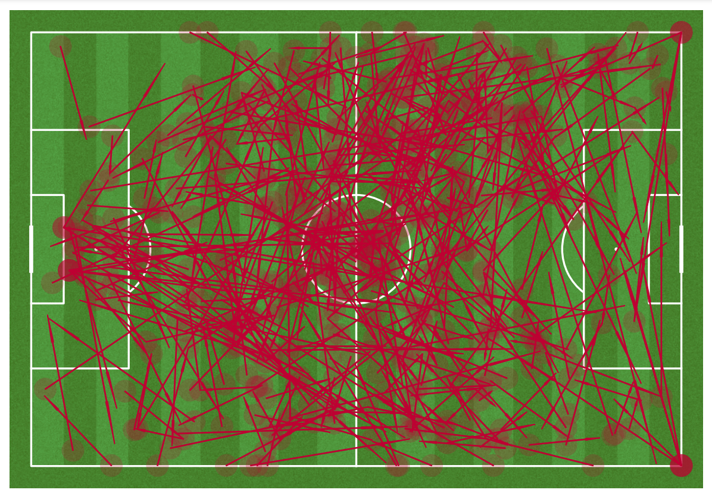
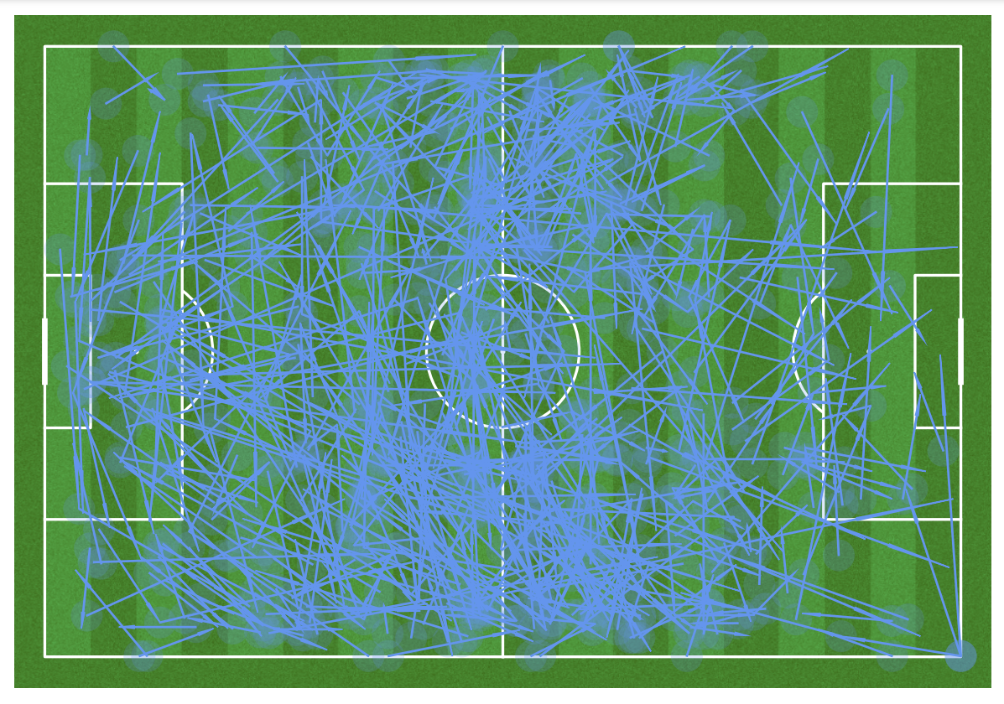
PASS MAP
A pass map is a graphical representation of all the passes that occur on the football field during a game.
Pass map of Barcelona Pass map of Real Madrid

Slide 9
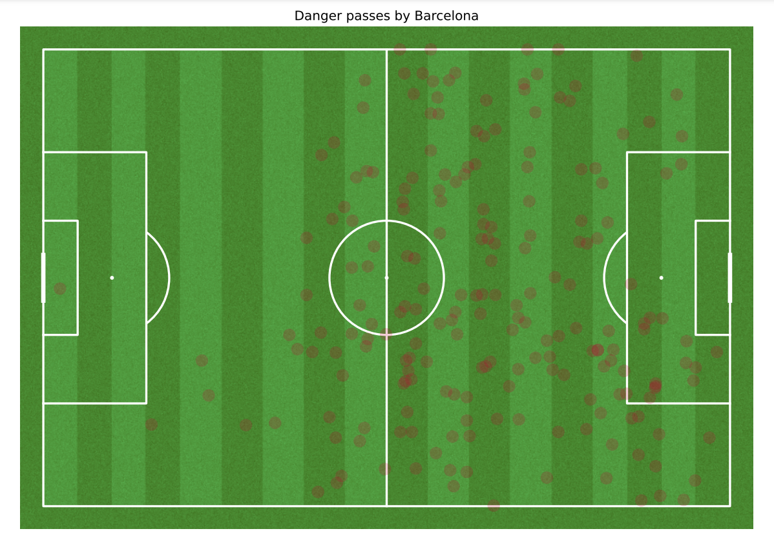
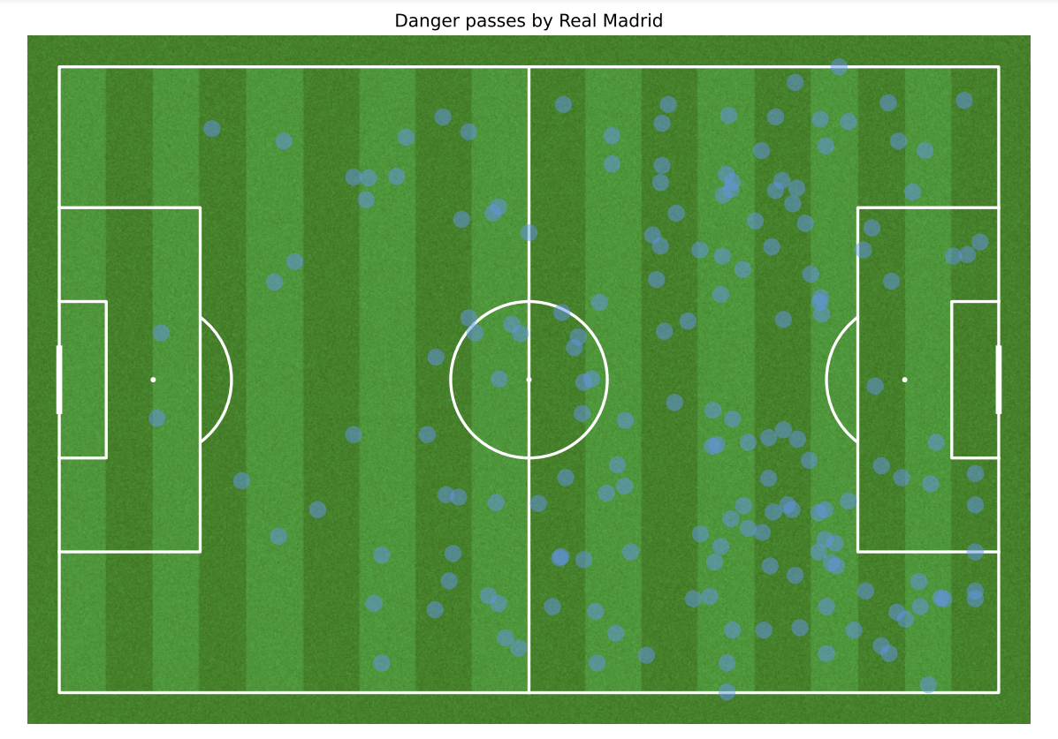
DANGEROUS PASS
A dangerous pass is defined as one that leads to a goal or, at the very least, an attempt at the goal. These passes are critical in determining the attacking prowess and effectiveness of a team.
Dangerous Pass map by Barcelona Dangerous Pass map by Real Madrid
Dangerous Pass map of Barcelona Dangerous Pass map of Real Madrid

Slide 10
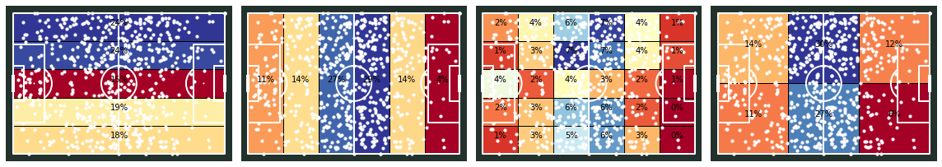
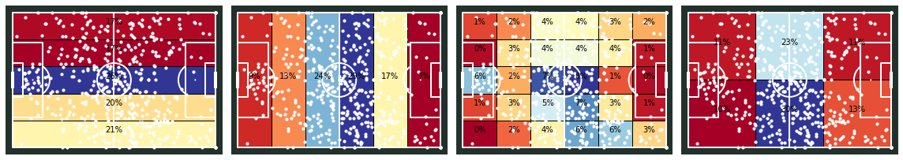
HEAT MAP
A heat map is a graphical representation of a football pitch that indicates the level of a player's activity and effectiveness in different parts of the field.
Heat map of Barcelona Heat map of Real Madrid

Slide 11
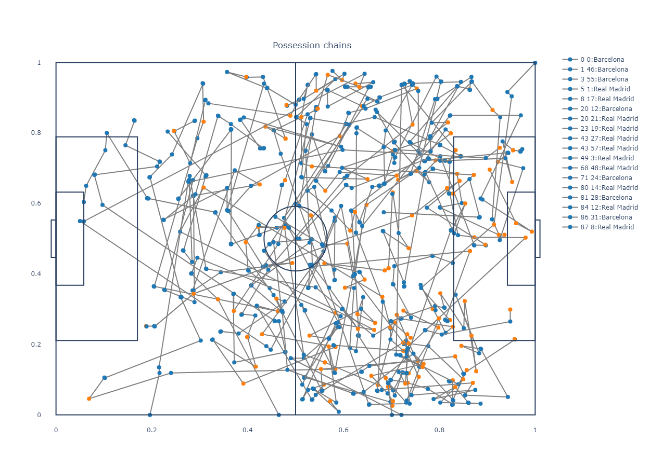
POSSESSION CHAIN
we have generated a possession chain for both teams, which provides an insight into the passing sequences without losing the ball to the opposing team.
Possession chains map of Real Madrid & Barcelona

Slide 12
PREDICTION OF GOALS
Through analysis we understood:
The shots and goals made by both the teams.
Pass network of both teams individually.
Dangerous passes made by a specific team through which the opposition can counter their rivals.
Frequency of moment of players of each team.
The passing patterns of both the teams.
Using the above data, the possibility of goal in football match is predicted.

Slide 13
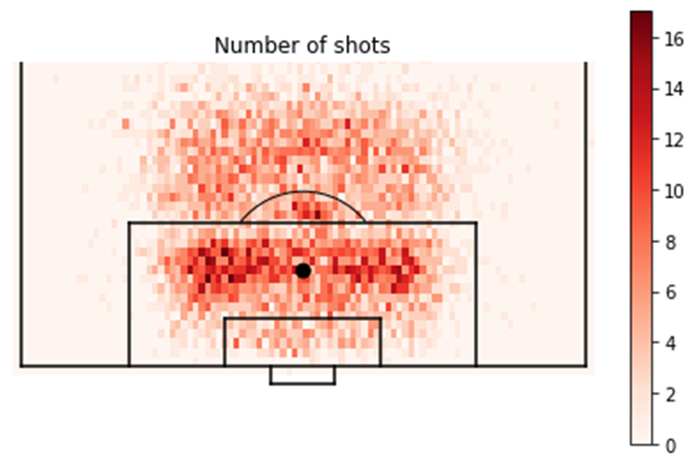
NUMBER OF SHOTS
The plot shown above represents the locations from which various shots on goal were attempted. It should also be noted that these are just attempts made to score a goal and not the actual goal.

Slide 14
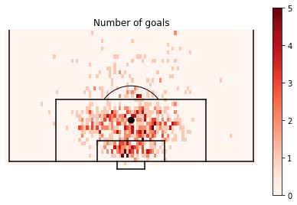
NUMBER OF GOALS
The plot above represents the locations from which various goals have occurred during open play.

Slide 15
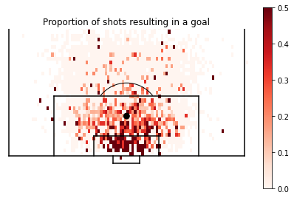
PROPORTION OF SHOTS TO GOAL
The plot shown above represents the probability of scoring from a specific location. It is created by taking the number of goals scored from a location and dividing it with the number of shots attempted from that position.

Slide 16
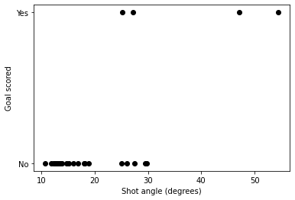
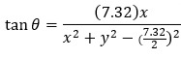
SHOT GOAL ANGLE

Slide 17
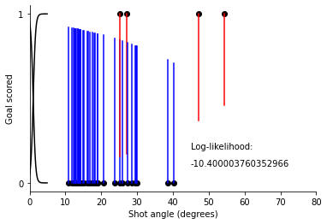
GOAL SCORED SHOT ANGLE
The graph shown above represents the log likelihood of a goal being scored from a given shot angle.

Slide 18
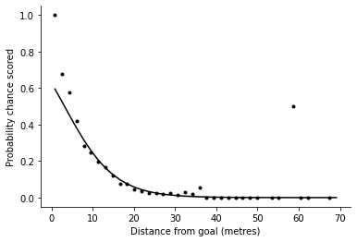
PROBABILITY OF SCORING DISTANCE
The graph shown above represents the probability of scoring from a certain distance from the goal. This can also be interpreted that the probability of scoring a goal decrease with increase in the distance from goal.

Slide 19
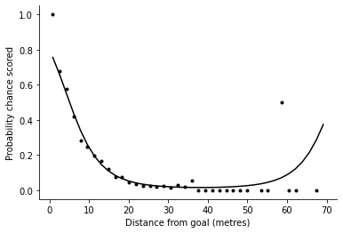
PROBABILITY OF SCORING DISTANCE SQUARED
The graph shown above represents the probability of the scoring distance squared. This can be done using linear regression and the derivation acquired is used in predicting the goals.

Slide 20
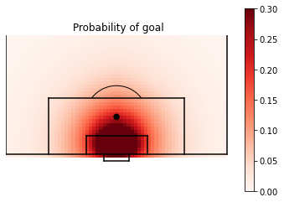
PROBABILITY OF GOAL
The plot shown above represents the probability of scoring a goal from a specific location using a heat map and fined tuned using linear regression.

Slide 21
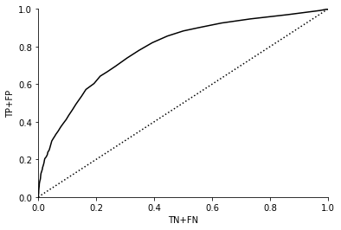
ROC CURVE
The graph shown above represents the ROC curve also curved as a Receiver Operating Characteristic curve which shows the performance of the prediction model at all the different thresholds.

Slide 22
THANK YOU

